Slide 1
Data Structures and Algorithms (10)
CS F211

Slide 2
Searching - Re-visited
Binary tree O(log n) if it stays balanced
  Simple binary tree good for static collections
  Low (preferably zero) frequency of insertions/deletions
but my collection keeps changing!
  It’s dynamic
  Need to keep the tree balanced
First, examine some basic tree operations
  Useful in several ways!

Slide 3
Tree Traversals
There are mainly three ways to traverse a tree:
Inorder Traversal
Postorder Traversal
Preorder Traversal

Slide 4
Inorder Traversal: A E H J M T Y
Visit second
tree
‘J’
‘E’
‘T’
‘A’
‘H’
‘M’
‘Y’
Visit left subtree first
Visit right subtree last

Slide 5
Inorder Traversal
Visit the nodes in the left subtree, then visit the root of the tree, then visit the nodes in the right subtree
    Inorder(tree)
    If tree is not NULL
    Inorder(Left(tree))
    Visit Info(tree)
    Inorder(Right(tree))
(Warning: "visit" means that the algorithm does something with the values in the node, e.g., print the value)

Slide 6
Postorder Traversal: A H E M Y T J
Visit last
tree
‘J’
‘E’
‘T’
‘A’
‘H’
‘M’
‘Y’
Visit left subtree first
Visit right subtree second

Slide 7
Postorder Traversal
Visit the nodes in the left subtree first, then visit the nodes in the right subtree, then visit the root of the tree
    Postorder(tree)
    If tree is not NULL
    Postorder(Left(tree))
    Postorder(Right(tree))
    Visit Info(tree)

Slide 8
Preorder Traversal: J E A H T M Y
Visit first
tree
‘J’
‘E’
‘T’
‘A’
‘H’
‘M’
‘Y’
Visit left subtree second
Visit right subtree last

Slide 9
Preorder Traversal
Visit the root of the tree first, then visit the nodes in the left subtree, then visit the nodes in the right subtree
    Preorder(tree)
    If tree is not NULL
    Visit Info(tree)
    Preorder(Left(tree))
    Preorder(Right(tree))

Slide 10
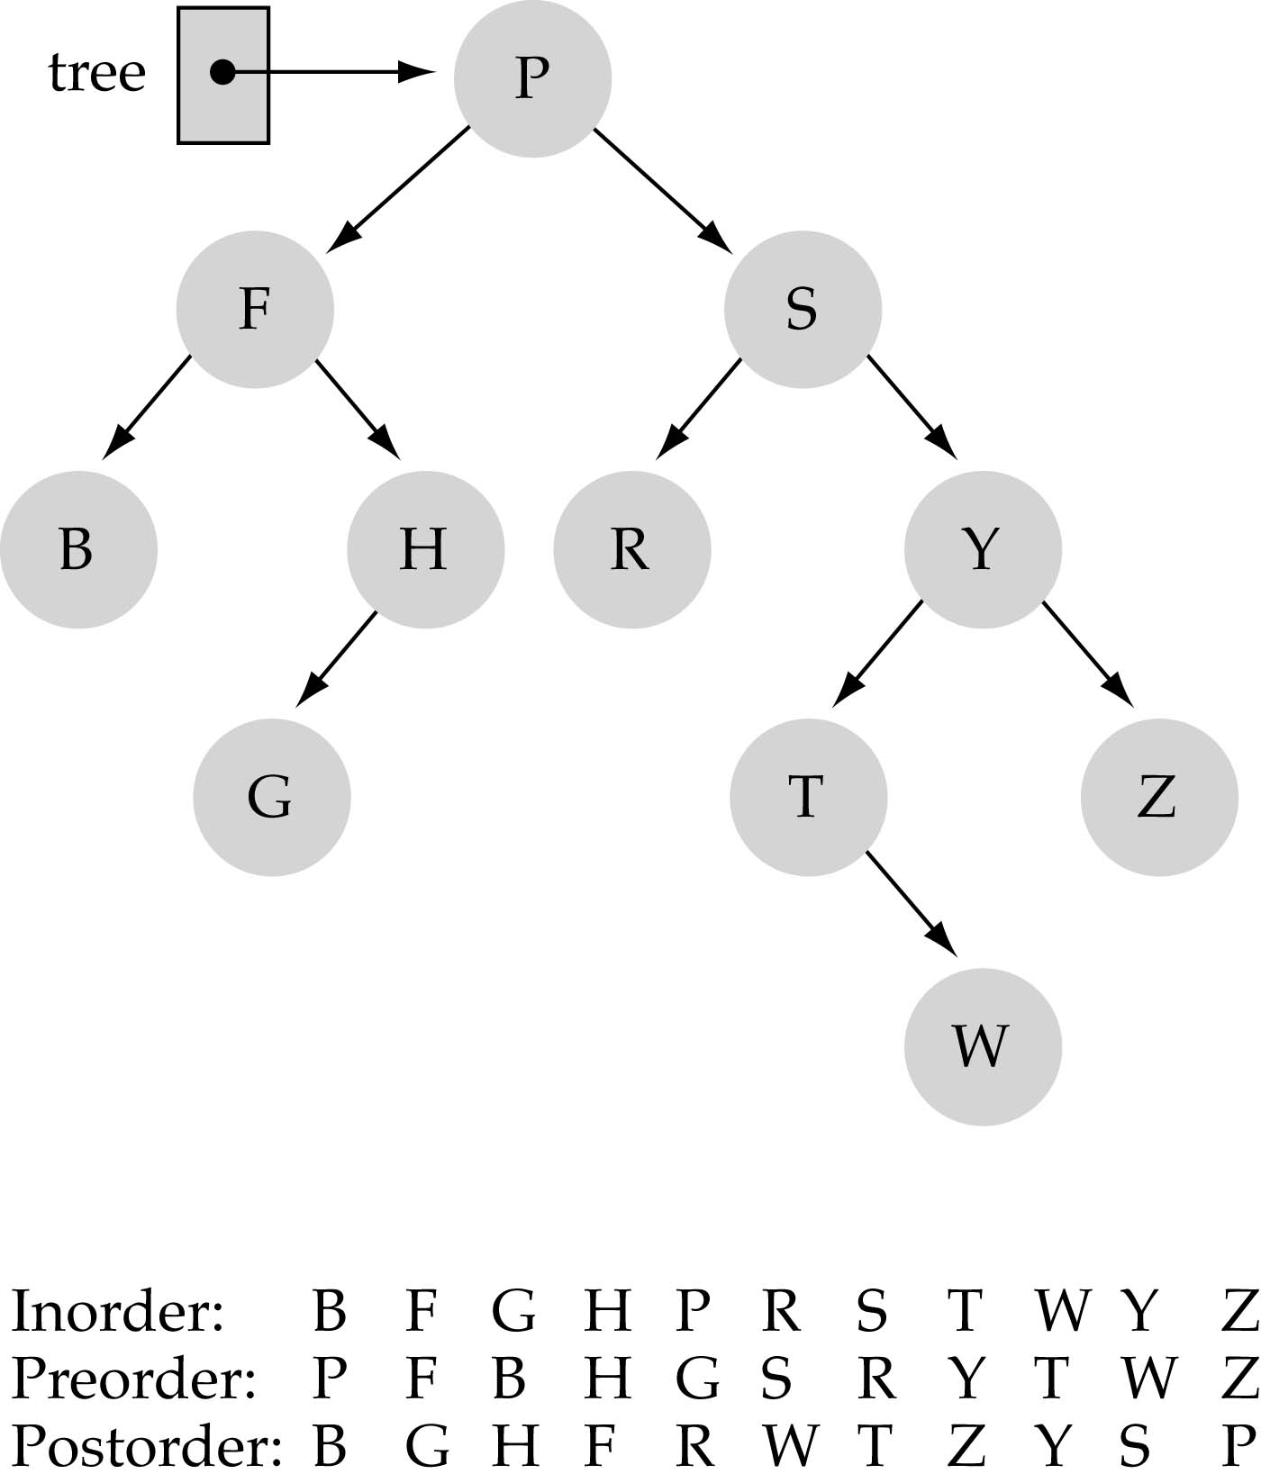
Tree Traversals

Slide 11
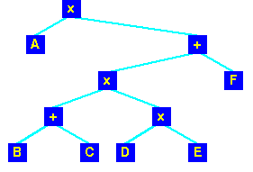
Tree Traversal
Traversal = visiting every node of a tree
Three basic alternatives
Pre-order
  Root
  Left sub-tree
  Right sub-tree
✶
→
✴
✵

x A + x + B C x D E F
L
R
L
L
R

Slide 12
Tree Traversal
Traversal = visiting every node of a tree
Three basic alternatives
In-order
  Left sub-tree
  Root
  Right sub-tree
✴
✶
✪

11
✵

A x B + C x D x E + F
→



L
L
R

Slide 13
Tree Traversal
Traversal = visiting every node of a tree
Three basic alternatives
Post-order
  Left sub-tree
  Right sub-tree
  Root
11
✶
✪


✵

A B C + D E x x F + x
✴


L
→
L
R

Slide 14
Tree Traversal
Post-order
  Left sub-tree
  Right sub-tree
  Root
Reverse-Polish
Normal algebraic form
  which traversal?
11
✶
✪


✵

(A (((BC+)(DEx) x) F +)x )
✴


→
(A x(((B+C)(DxE))+F))

Slide 15
Does the order of inserting elements into a binary search tree matter?
Yes, certain orders produce very unbalanced trees!!
Unbalanced trees are not desirable because search time increases!!
There are advanced tree structures (e.g.,"red-black trees") which guarantee balanced trees

Slide 16
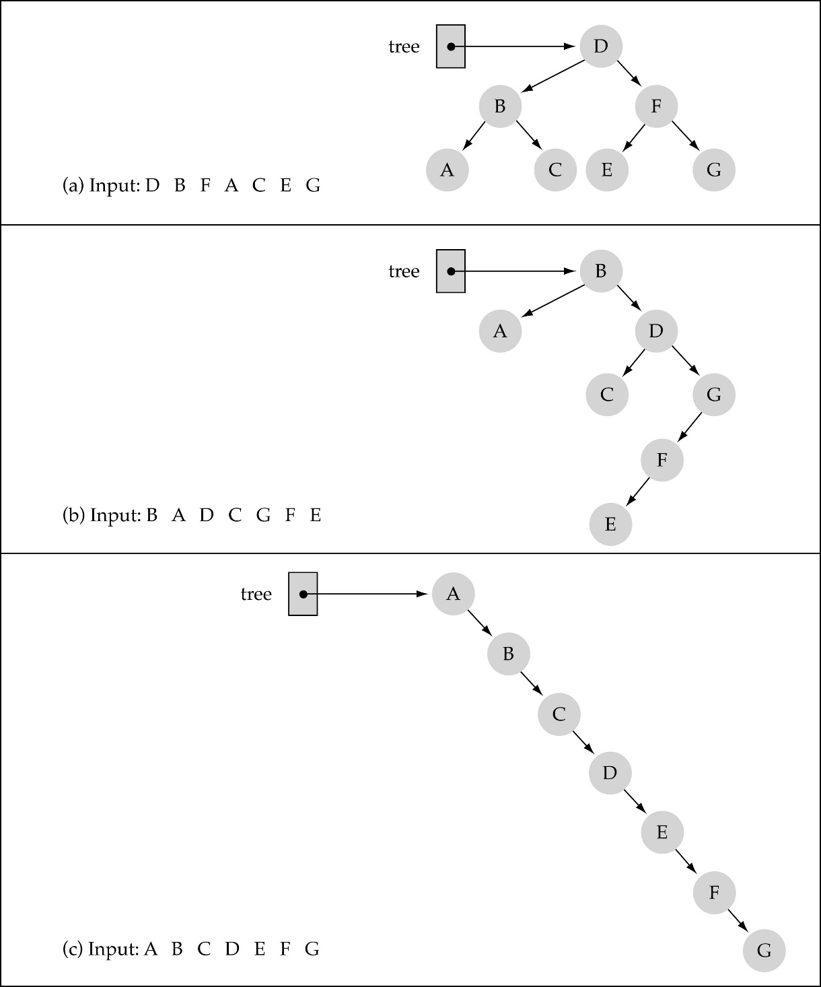
Does the order of inserting elements into a tree matter?
(cont.)

Slide 17
Function DeleteItem
First, find the item; then, delete it
Important: binary search tree property must be preserved!!
We need to consider three different cases:
(1) Deleting a leaf
(2) Deleting a node with only one child
(3) Deleting a node with two children

Slide 18
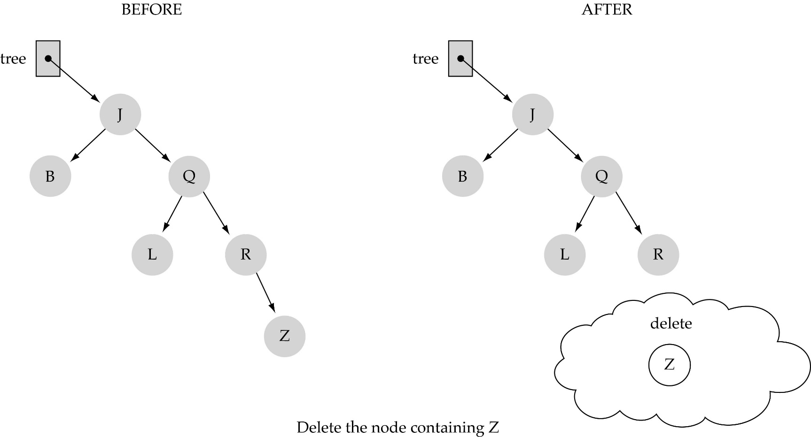
(1) Deleting a leaf

Slide 19
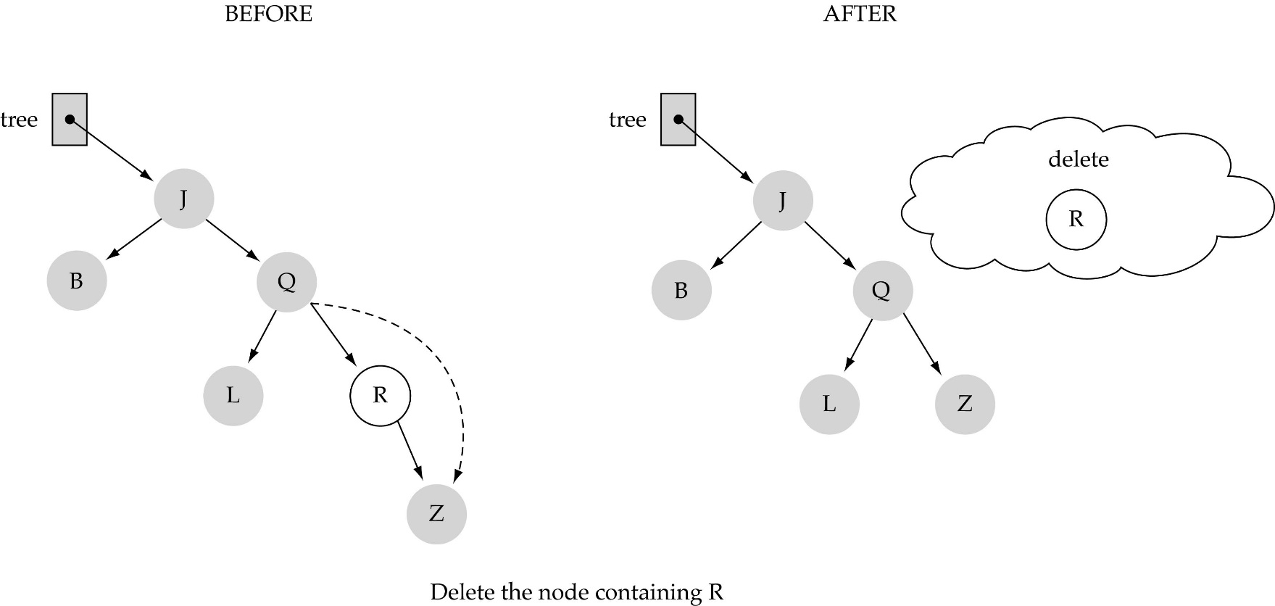
(2) Deleting a node with only one child

Slide 20
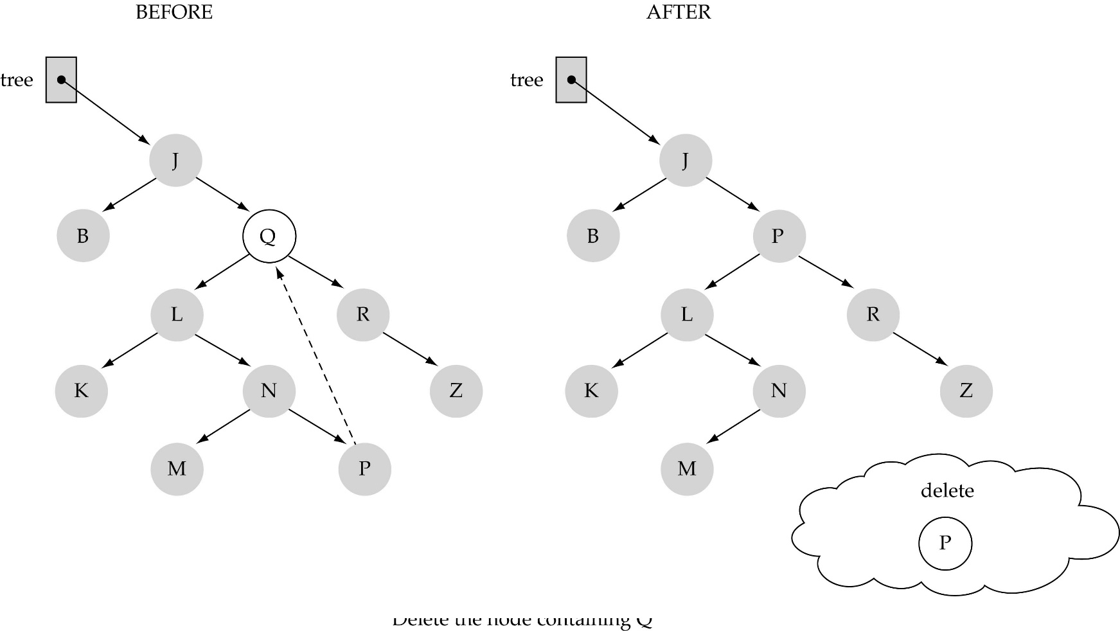
(3) Deleting a node with two children

Slide 21
(3) Deleting a node with two children (cont.)
Find predecessor (it is the rightmost node in the left subtree)
Replace the data of the node to be deleted with predecessor's data
Delete predecessor node

Slide 22
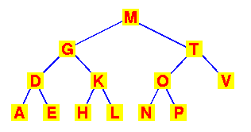
Trees - Searching
Binary search tree
  Produces a sorted list by in-order traversal
In order: A D E G H K L M N O P T V

Slide 23
Thank You!!

